Slide 1
Job Portal System
Group Number: 53
Parth Goti(201706100110042)
Dhruvi Vaghela (201706100110122)
Guided by
Mrs. Preeti Bhatt

Slide 2
1. INTRODUCTION
PURPOSE
The purpose of the project is to build an application program to reduce the manual work for managing the Interview , Employer , Post Job , Call Letter .It tracks all the details about the Call Letter ,Employer Registration , Search Job.
SCOPE
In this system Catalog section will be visit by any one and Job Portal system accessed by only owner of the company and HR(Job Provider) of the company.

Slide 3
2. SYSTEM ANALYSIS
IDENTIFICATION OF NEEDS
The present manual system is based on paperwork which contain several redundant documentation.
Important data is lost in paperwork.
The present system provide slow services.So to remove limitation we proposed to develop a web system that will manage job and job seekers.
TECHNOLOGY USED
CLIENT SIDE:
HTML (Mixed with ASP.NET)
CSS
JavaScript
SERVER SIDE:
ASP.NET
C#
DATABASE:
SQL Server 2008 R2

Slide 4
FUNCTIONAL REQUIREMENTS
Login and Registration:
Owner /HR(Job Provider) can login with their unique username or password.
Job Seeker can registration into the system and login with their username or password.
Feedback:
Owner should be able to view the feedback of job seeker.
Job seeker should be able to give a feedback.

Slide 5
Profile:
Owner and Job Provider(HR) should be able to view the profile of job seeker.
Add Job description:
Job provider(HR) should be able to add job description.
Update new Job vacancy:
Job provider(HR) should be able to update new job vacancy.
Remove Job:
Job provider(HR) should be able to update new job vacancy.

Slide 6
Search and apply Job:
Job seeker should be able to search and apply for job.
Owner and Job Provider(HR) should be able to change status (approve/reject) of the job application.
Job Seeker should be able to view the status(approve/reject) of job application.

Slide 7
NON-FUNCTIONAL REQUIREMENTS
Accessibility:
The User’s password will be stored securely in encrypted form by using Microsoft Visual Studio in-built MD5 algorithm.
Job seeker can not view the data of Job provider(HR).

Slide 8
MODULES
Module1: Registration and Authentication
In this module owner and HR can authenticate via their unique username and password into the system. In this module user can view their profile details (like username, contact no, address) and user can also change the password in this module. In this module owner can add, update, delete job details.
Module2: Job and description
Job and about Job(description of job) entered by HR(job provider) into the system. Owner and HR(Job Provider) have rights in this system for add, update, delete. Visitor can only visit the web site and only see the job and description.

Slide 9
Module3: Job Application
For applying a job Registration and login is compulsory for the Job Seeker. In Job Seeker Profile only job seeker can add, update, delete in their profile. Owner HR(Job Provider) can view only the application of job seeker.
Owner and Job Provider(HR) update the status of job application and Jobseeker can only view the status of job application
Module4: Feedback
Job seeker give the feedback into the system. Owner and HR(Job Provider) can only view the feedback of jobseeker.

Slide 10
USER CHARACTERISTICS
Owner/Admin:
Owner can updating a status. Owner should be able to view the feedback of job seeker. Owner can registration of HR(Job Provider) and view the profile of Job Seeker.
HR(Job Provider):
In this module owner and HR can authenticate via their unique username and password into the system. In this module user can view their profile details (like username, contact no, address) and user can also change the password in this module. In this module owner can add, update, delete job details.

Slide 11
Job Seeker:
Job seeker can registration and login into the system. Job seeker can view and search all types of jobs. Job seeker can apply for job. Job seeker can view the status of Job Application approve/reject.
Visitor:
Visitor can only show our site checked or view about the Jobs and description if it like that and apply for job then registration into the system.

Slide 12
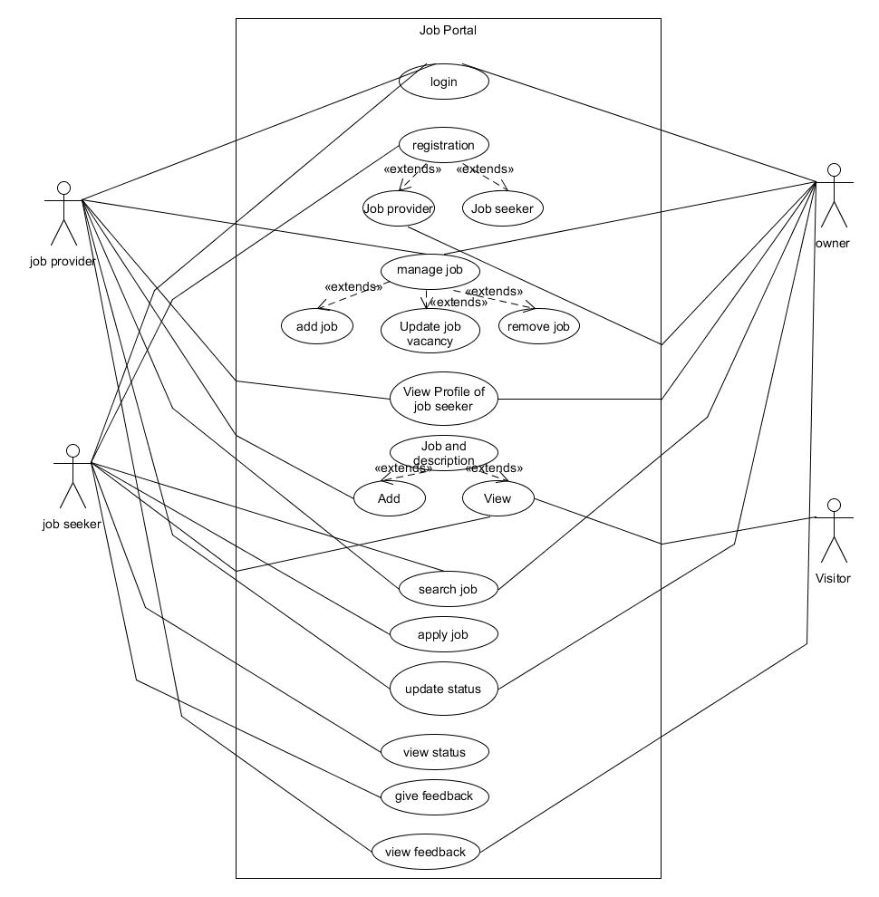
3. UML DIAGRAM USE CASE DIAGRAM

Slide 13
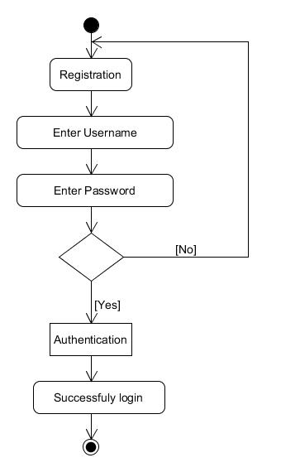
ACTIVITY DIAGRAM
LOGIN

Slide 14
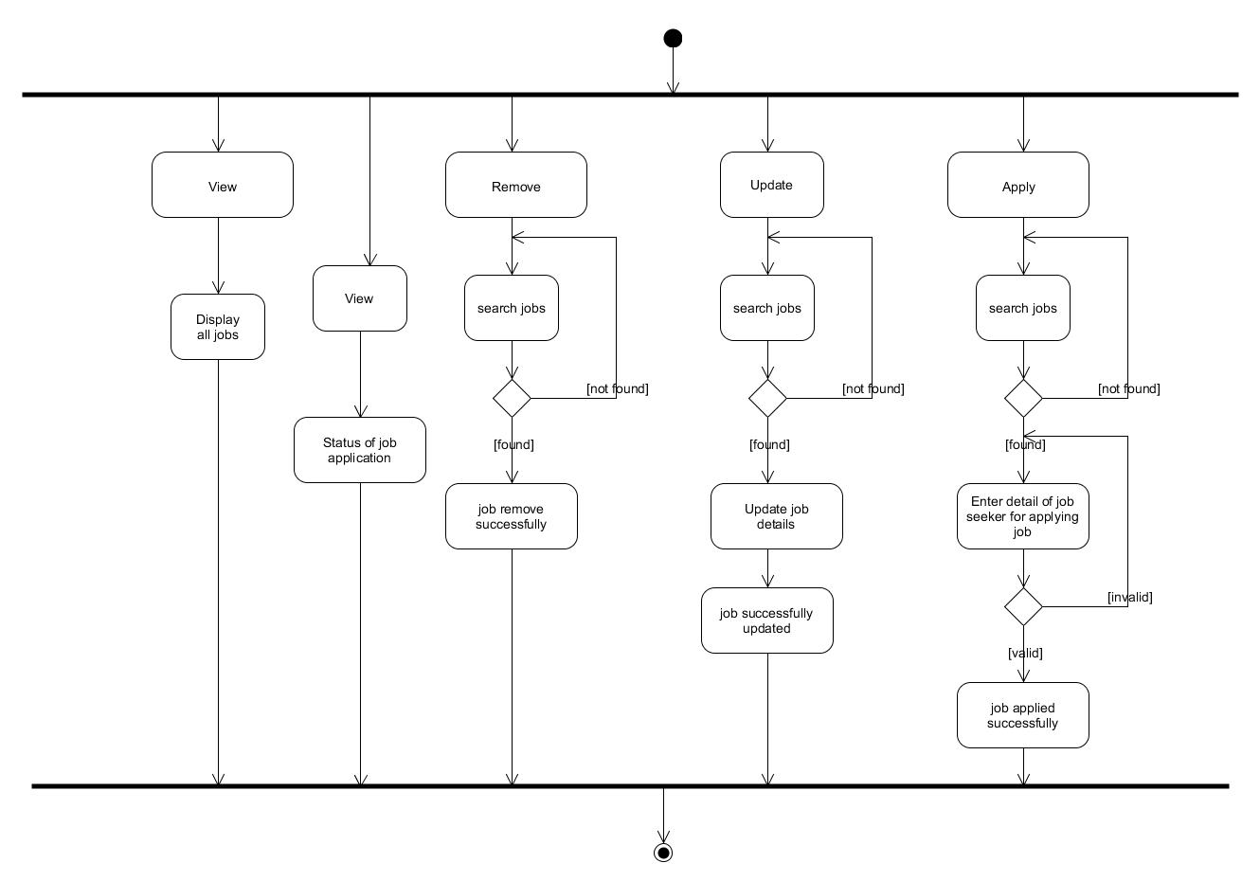
Job Application

Slide 15
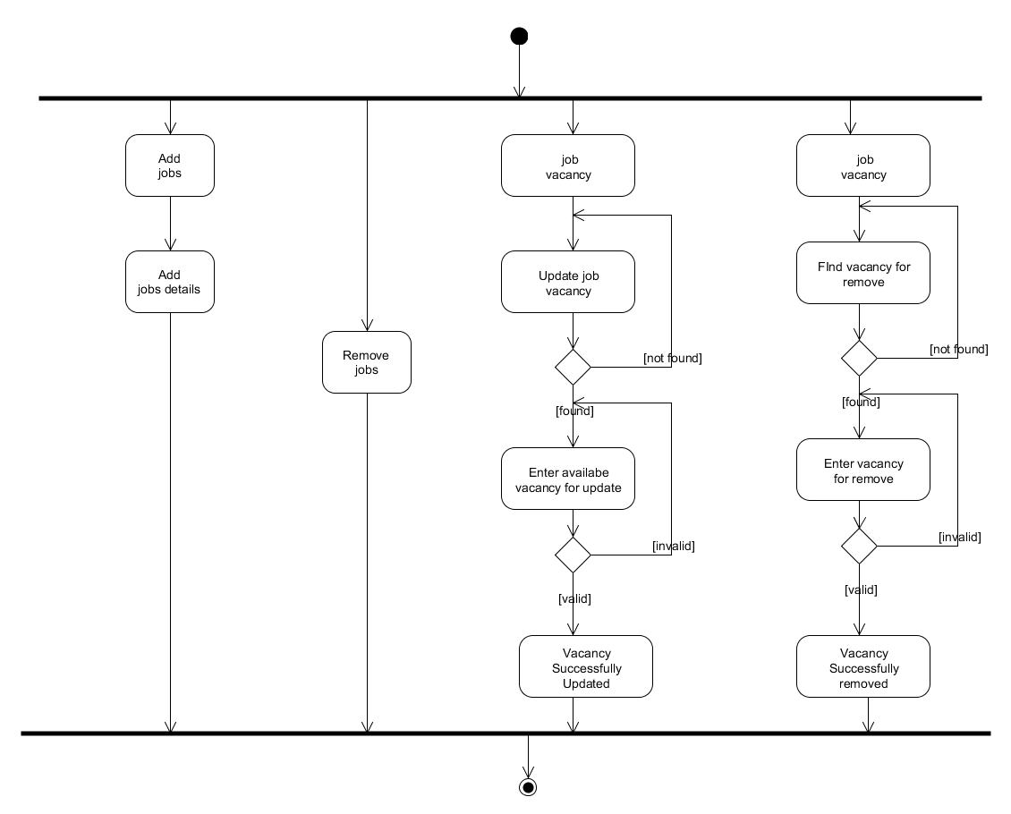
Manage Job

Slide 16
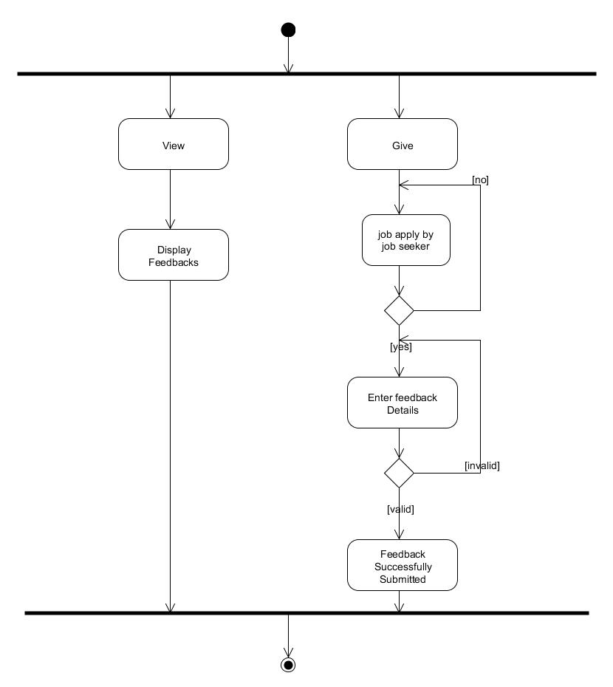
Feedback:

Slide 17
4. SYSTEM DESIGN
DATA DICTIONARY
Table Name: tblLogin
Field Name | Data Type | Size | Constraint | Description
LogInId | int | 11 | Primary Key | It’s loginid for Owner,HR and Candidate.
Email | Varchar | 255 | Not Null | It’s having email id for login and authentication.
Password | Varchar | 12 | Not Null | Password of authenticate user whose login into the system.
User_type | Varchar | 1 | Not Null | It’s describe which type of user login into the system.

Slide 18
Table Name: tblUserInfo
FIELD NAME | DATA TYPE | SIZE | CONSTRAINTS | DESCRITPTION
UserInfoId | int | 11 | Primary Key | It’s contains userinfo id which is used system.
LogInId | int | 11 | Foreign Key | It’s contains loginid into the system.
Email | Varchar | 255 | Not Null | It’s contains email as username.
Fame | Varchar | 25 | Not Null | It’s Contains First Name.
Lname | Varchar | 25 | Not Null | It’s Contains Last Name.

Slide 19
FIELD NAME | DATA TYPE | SIZE | CONSTRAINTS | DESCRITPTION
Dob | Date |  | Not Null | It’s contains Date Of Birth.
State | Varchar | 30 | Not Null | It’s Contains State.
Gender | Char | 1 | Not Null | It’s Contains Gender of user.
Address | Varchar | 65 | Not Null | It’s Contains Address.
Resume | Varchar | 30 | Not Null | It’s contains pdf file for candidate or HR.

Slide 20
FIELD NAME | DATA TYPE | SIZE | CONSTRAINTS | DESCRITPTION
Hedu | Varchar | 30 | Not Null | It’s contains education of user.
Mobile_no | varchar | 10 | Not Null | It contains contact info of user.
Marital_status | Char | 1 | Not Null | It contains a marital status.
Department | Varchar | 30 | Not Null | It contains a department name

Slide 21
Table Name: tblApplication
FIELD NAME | DATA TYPE | SIZE | CONSTRAINTS | DESCRITPTION
ApplicationId | int | 11 | Primary key | It contains job id which is used in system by hr.
Jobid | int | 11 | Foreign key | It contains a job id.
ApplicantId | int | 11 | Foreign key | It contains id of job seeker id which is used in system.
Email | Varchar | 255 | Not Null | It contains user name for login into the system.
Status | Char | 1 | Not Null | It contains a name of which one is applied for job.
Remark | Varchar | 60 | Not Null | It contains a remark for approve or rejection.

Slide 22
Table Name: tblJobs
FIELD NAME | DATA TYPE | SIZE | CONSTRAINTS | DESCRITPTION
JobId | int | 11 | Not Null | It contains job id which is used in system.
title | Varchar | 30 | Not Null | It contains job name.
Job_type | Varchar | 40 | Not Null | It contains a job type
Location | Varchar | 60 | Not Null | It contains location.
Company | Varchar | 30 | Not Null | It contains company name.
Description | Varchar | 50 | Not Null | It contains description for job
Req_experience | Varchar | 20 | Not Null | It contains req experience for job
Expected_salary | Varchar | 30 | Not Null | It contains salary
JobCreatedByUserId | int | 11 | Not Null | It contains userid of which add a job.

Slide 23
Table Name: tblrating
FIELD NAME | DATA TYPE | SIZE | CONSTRAINTS | DESCRITPTION
Rid | int | 11 | Primary key | It contains rating id.
Loginid | int | 11 | Foreign key | It contains a login id.
User_type | Char | 1 | - | It contains User type
Star | int | 11 | - | It contains a no of star which is given by user out of 5.
Comment | Vachar | 25 | - | It contains a comment for rating.

Slide 24
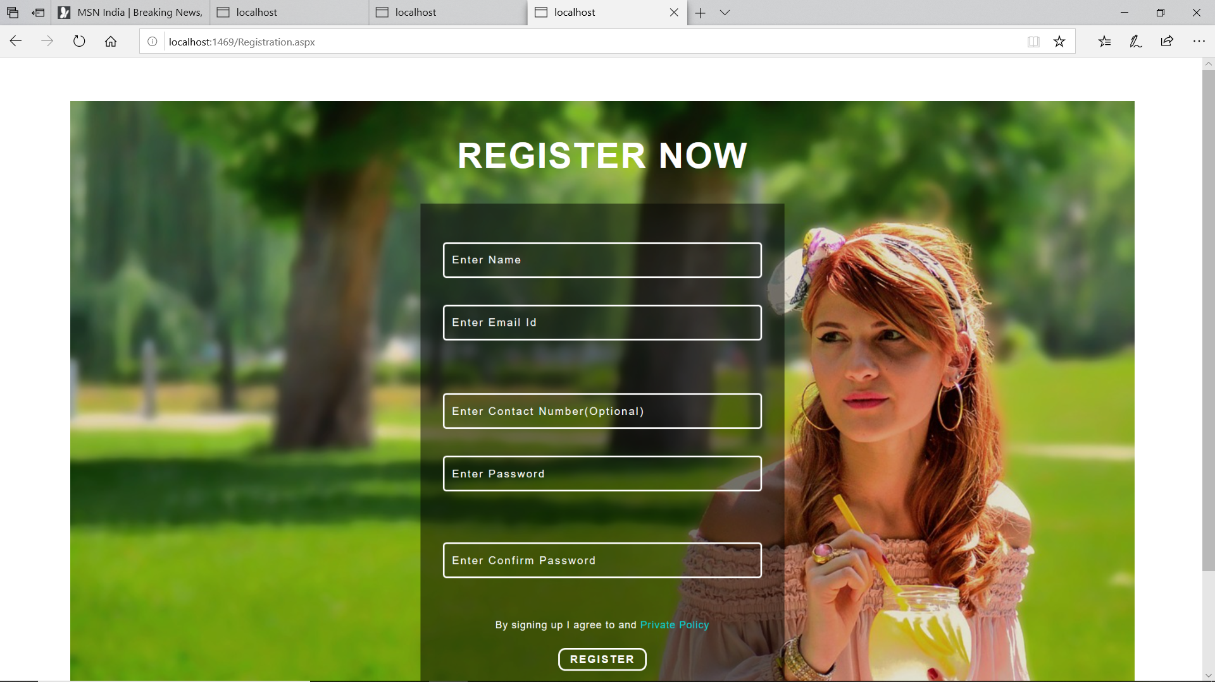
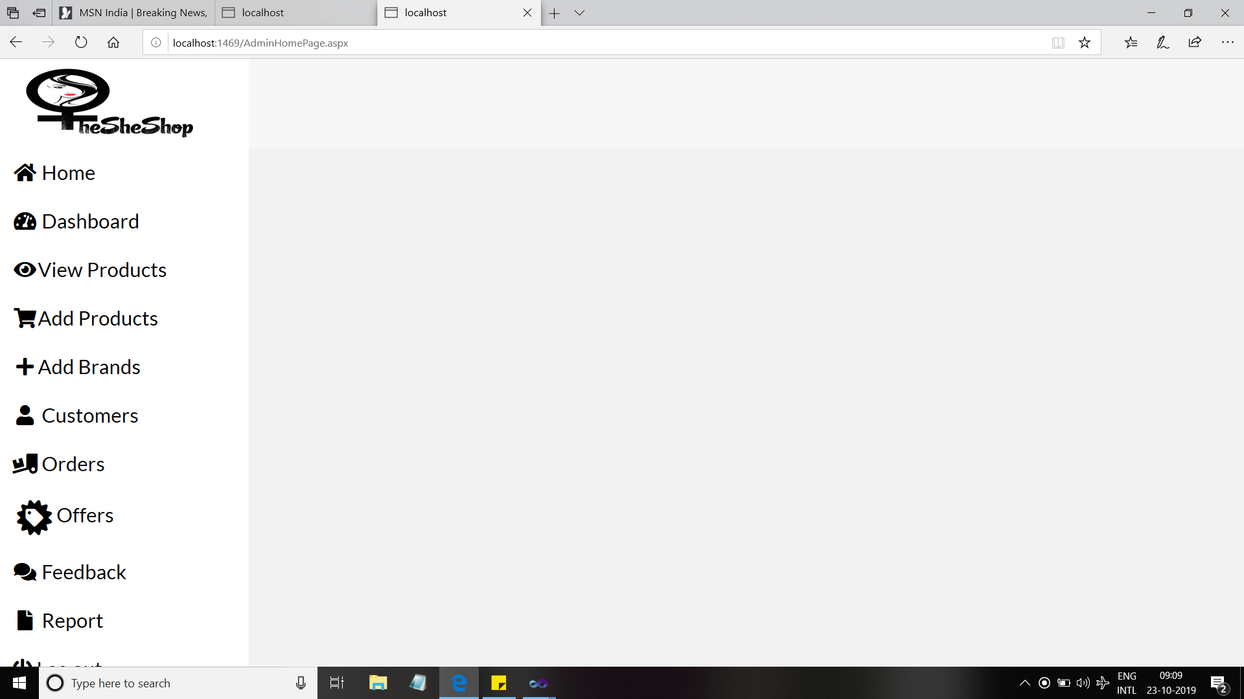
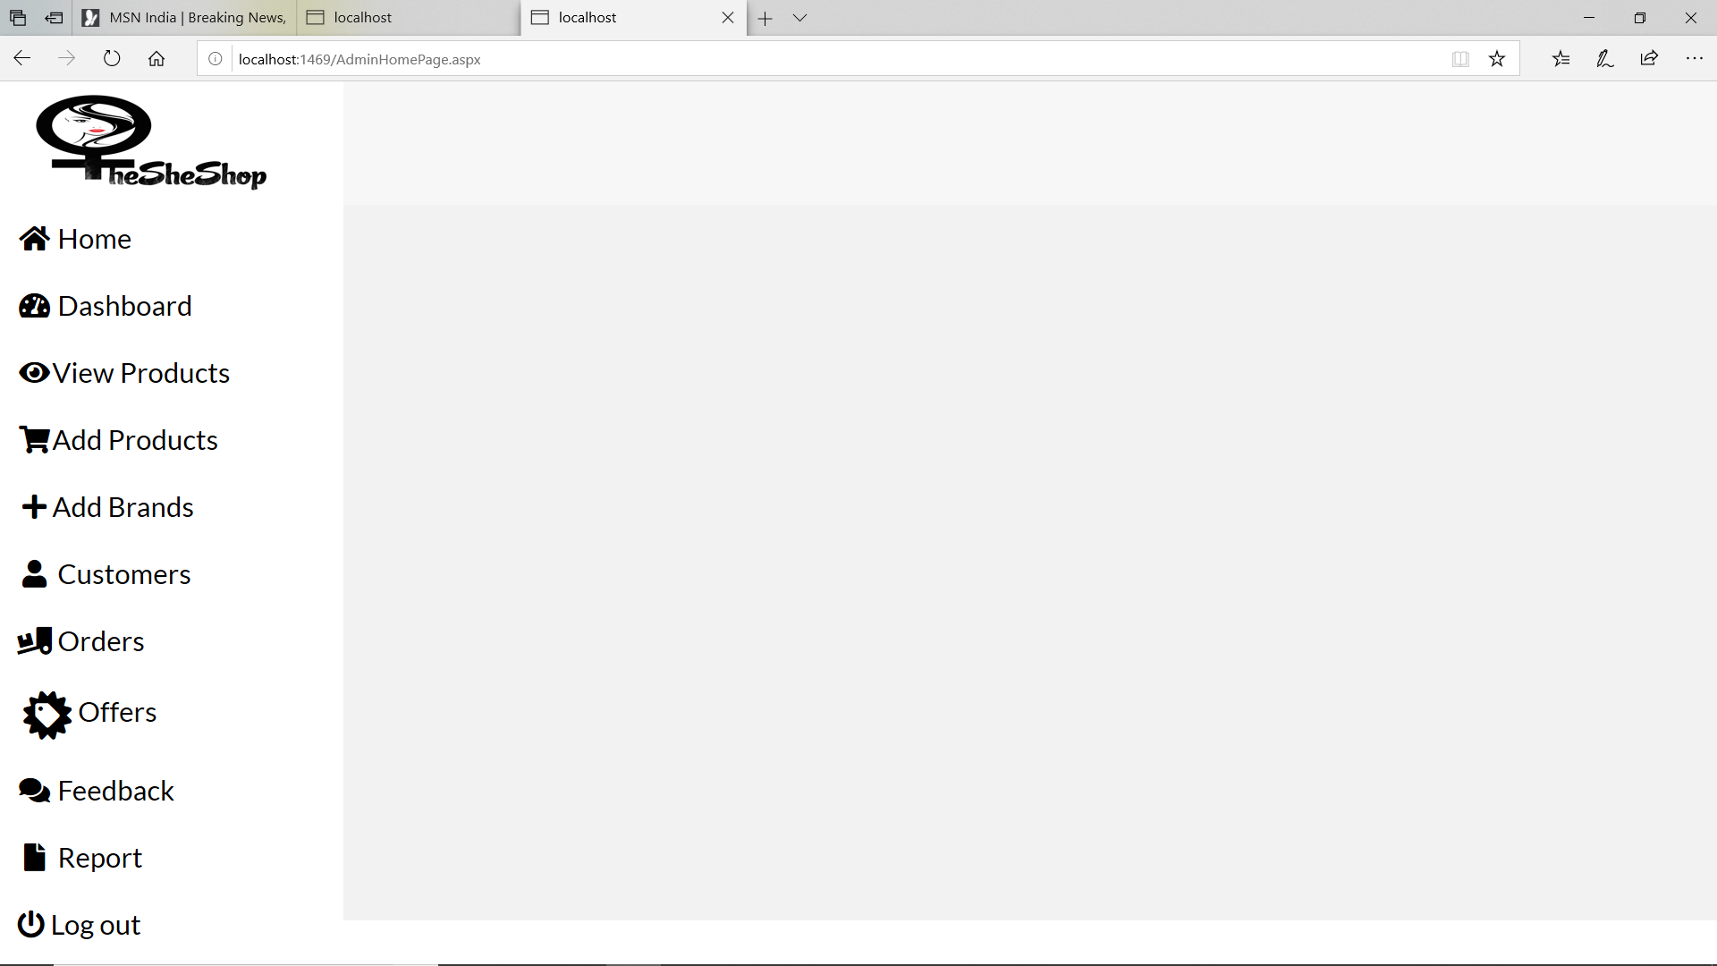
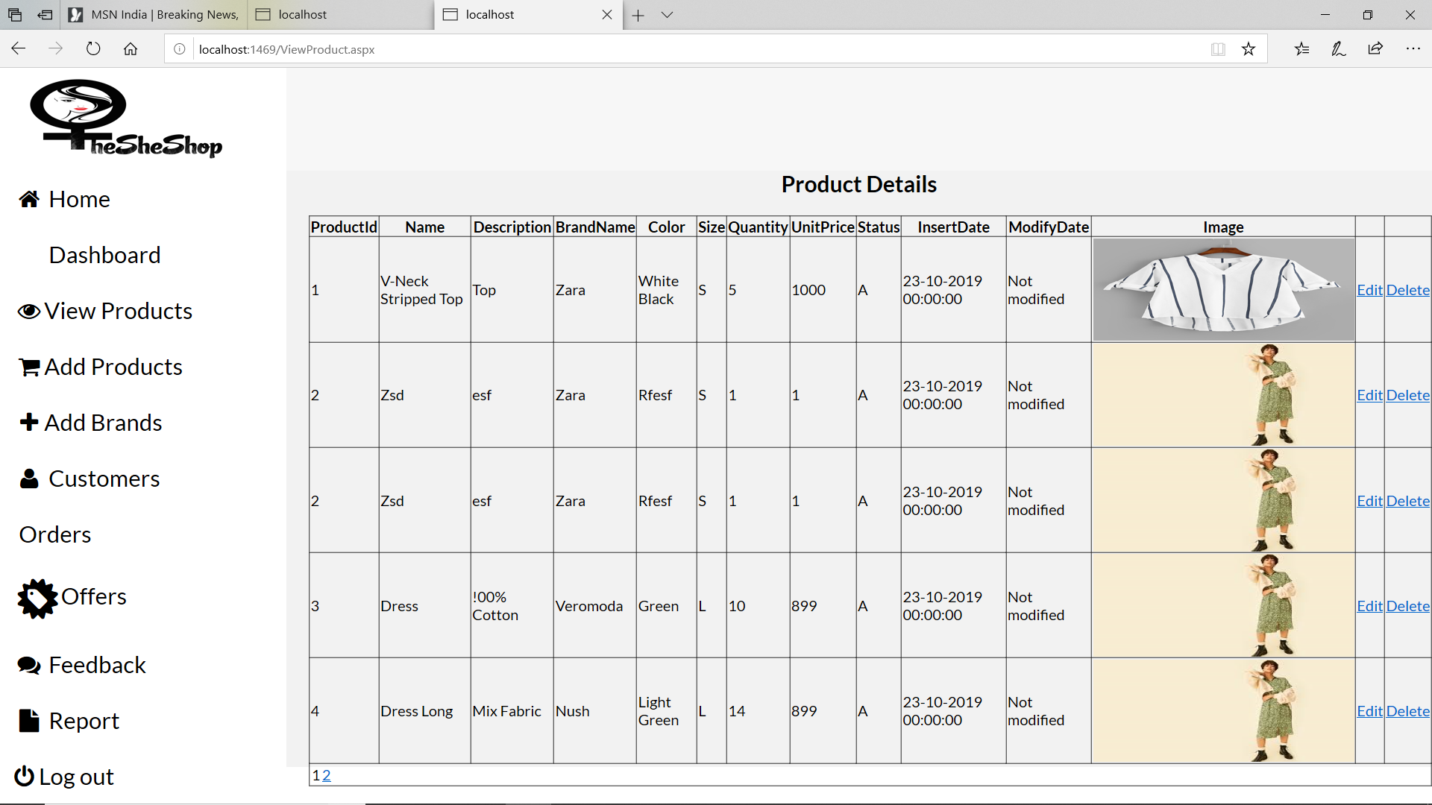
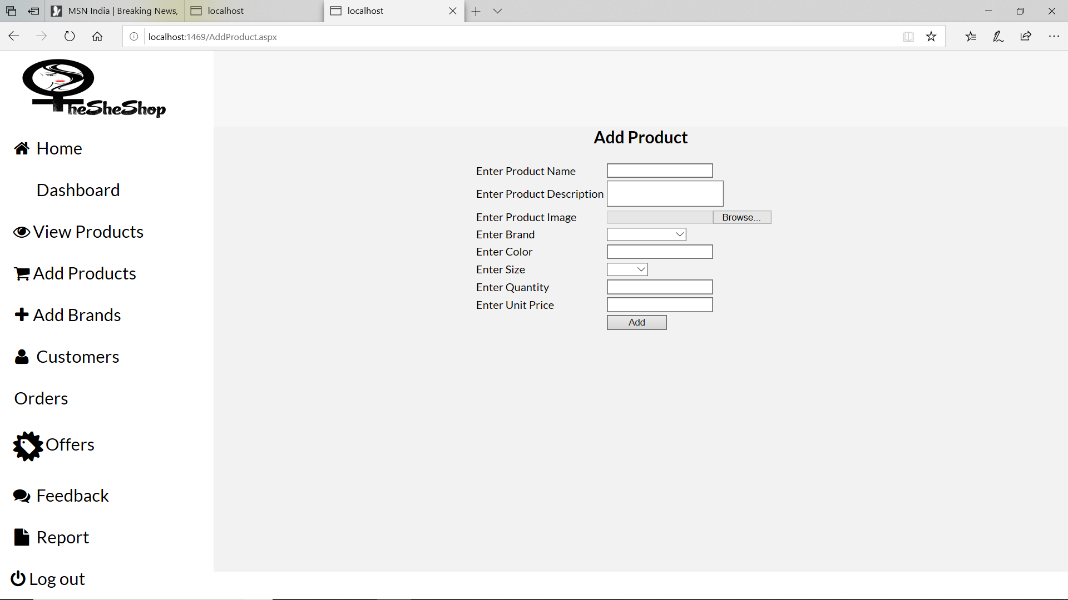
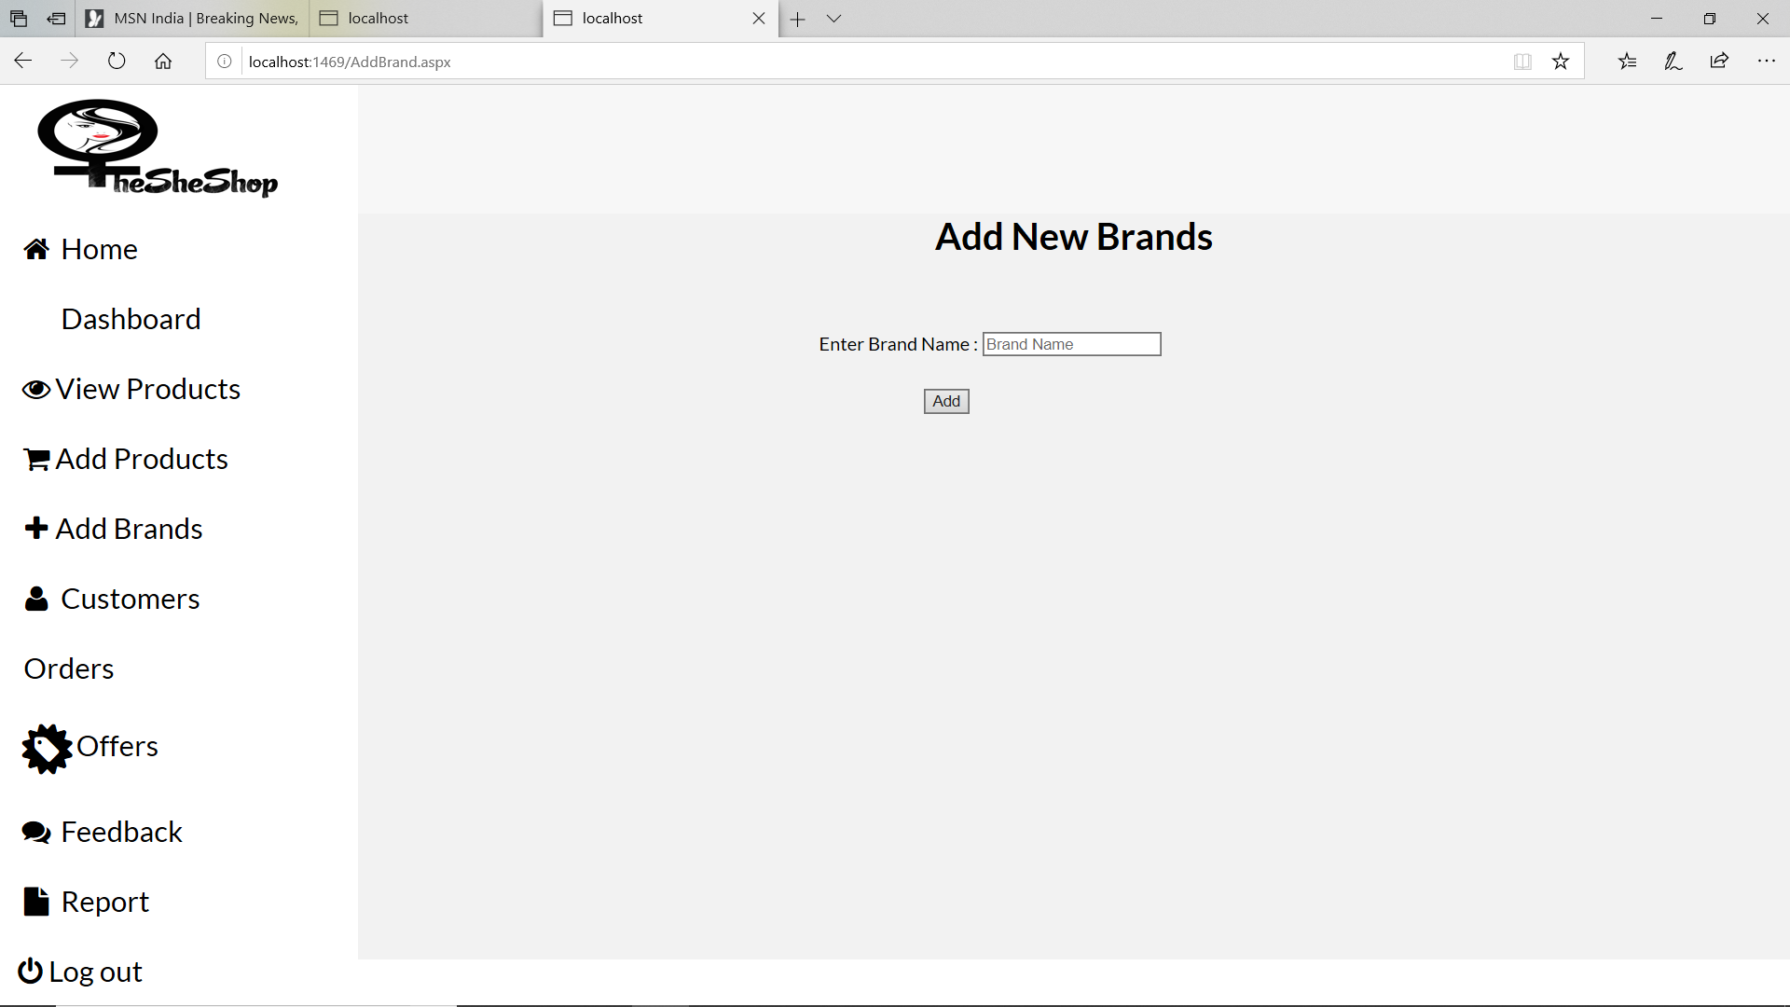
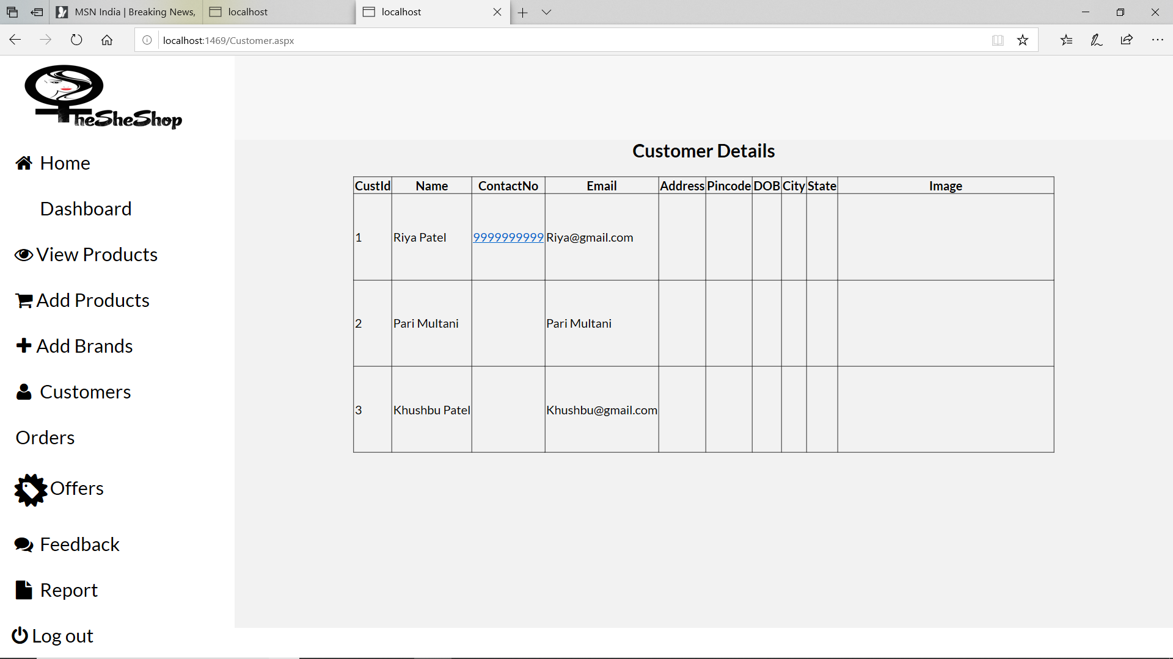
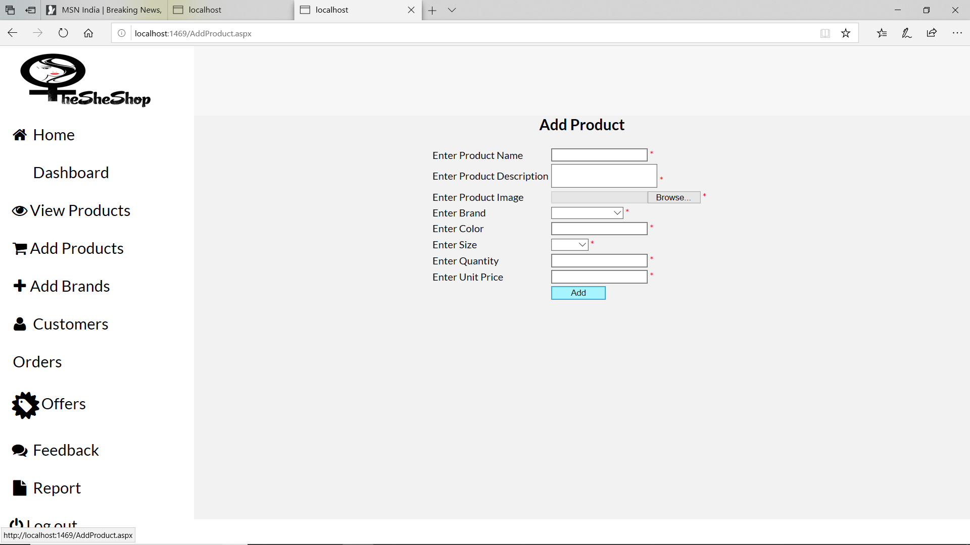
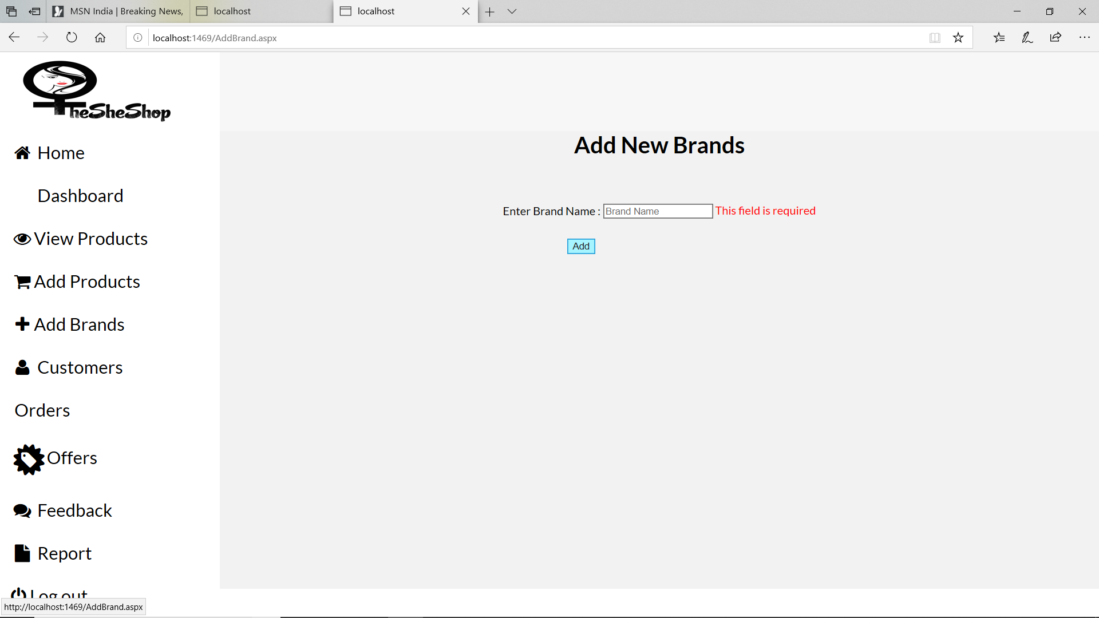
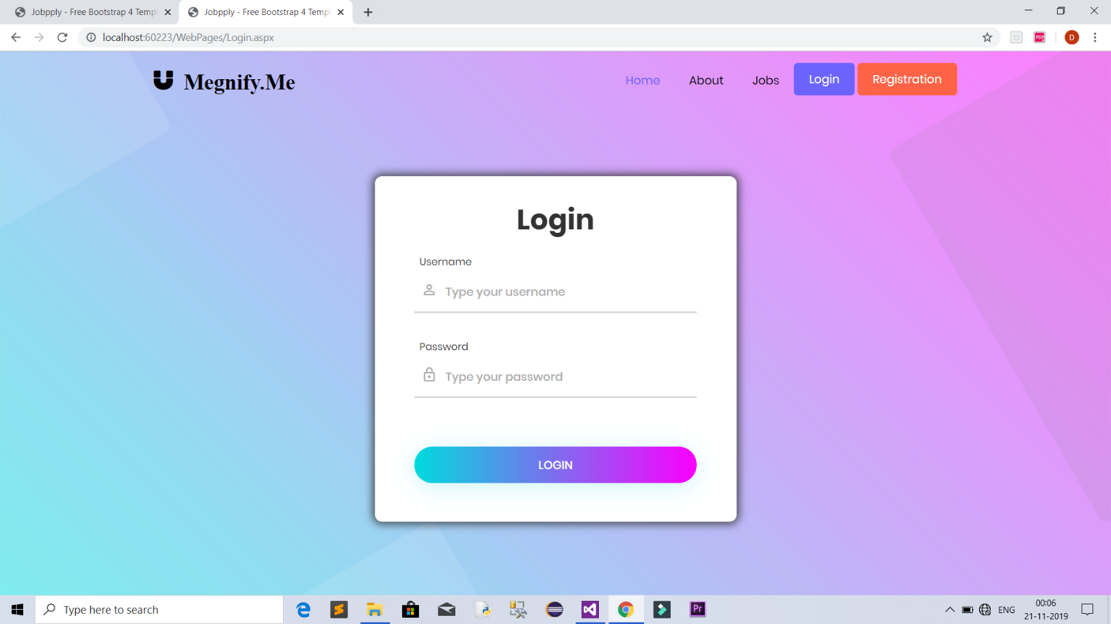
USER INTERFACE

Slide 25
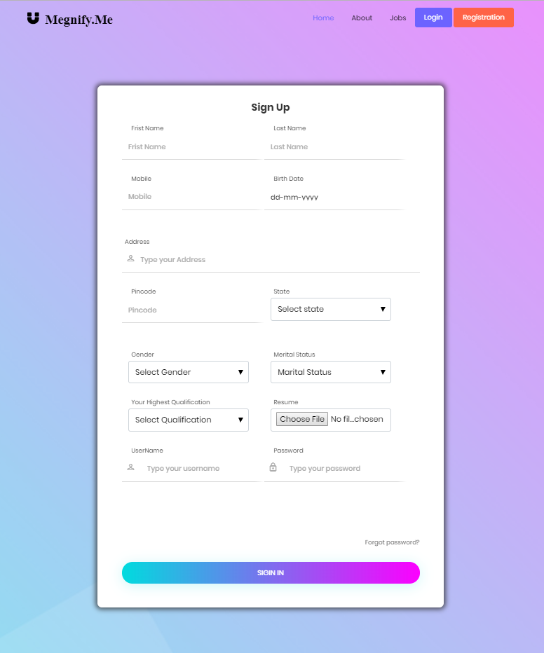

Slide 26
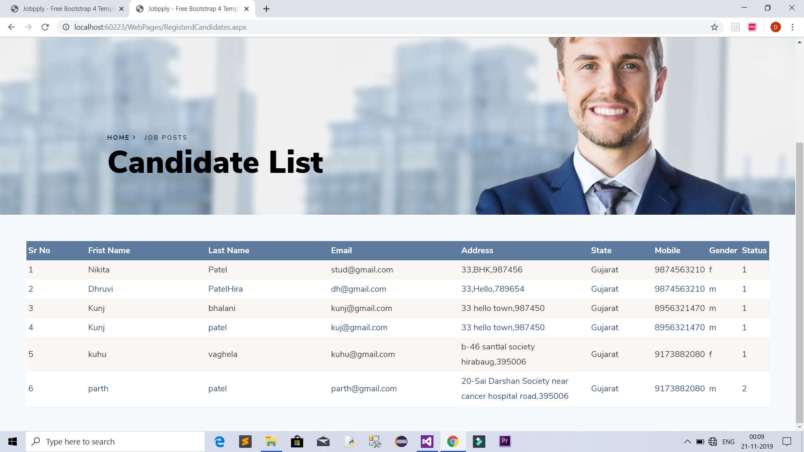

Slide 27
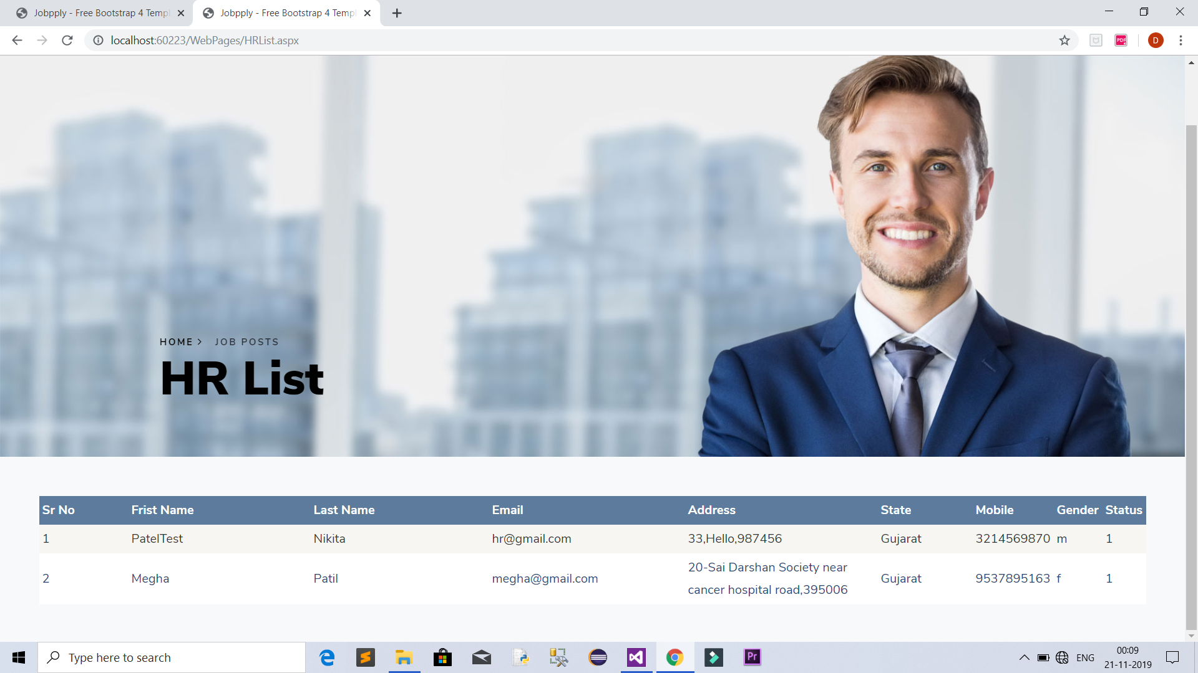

Slide 28
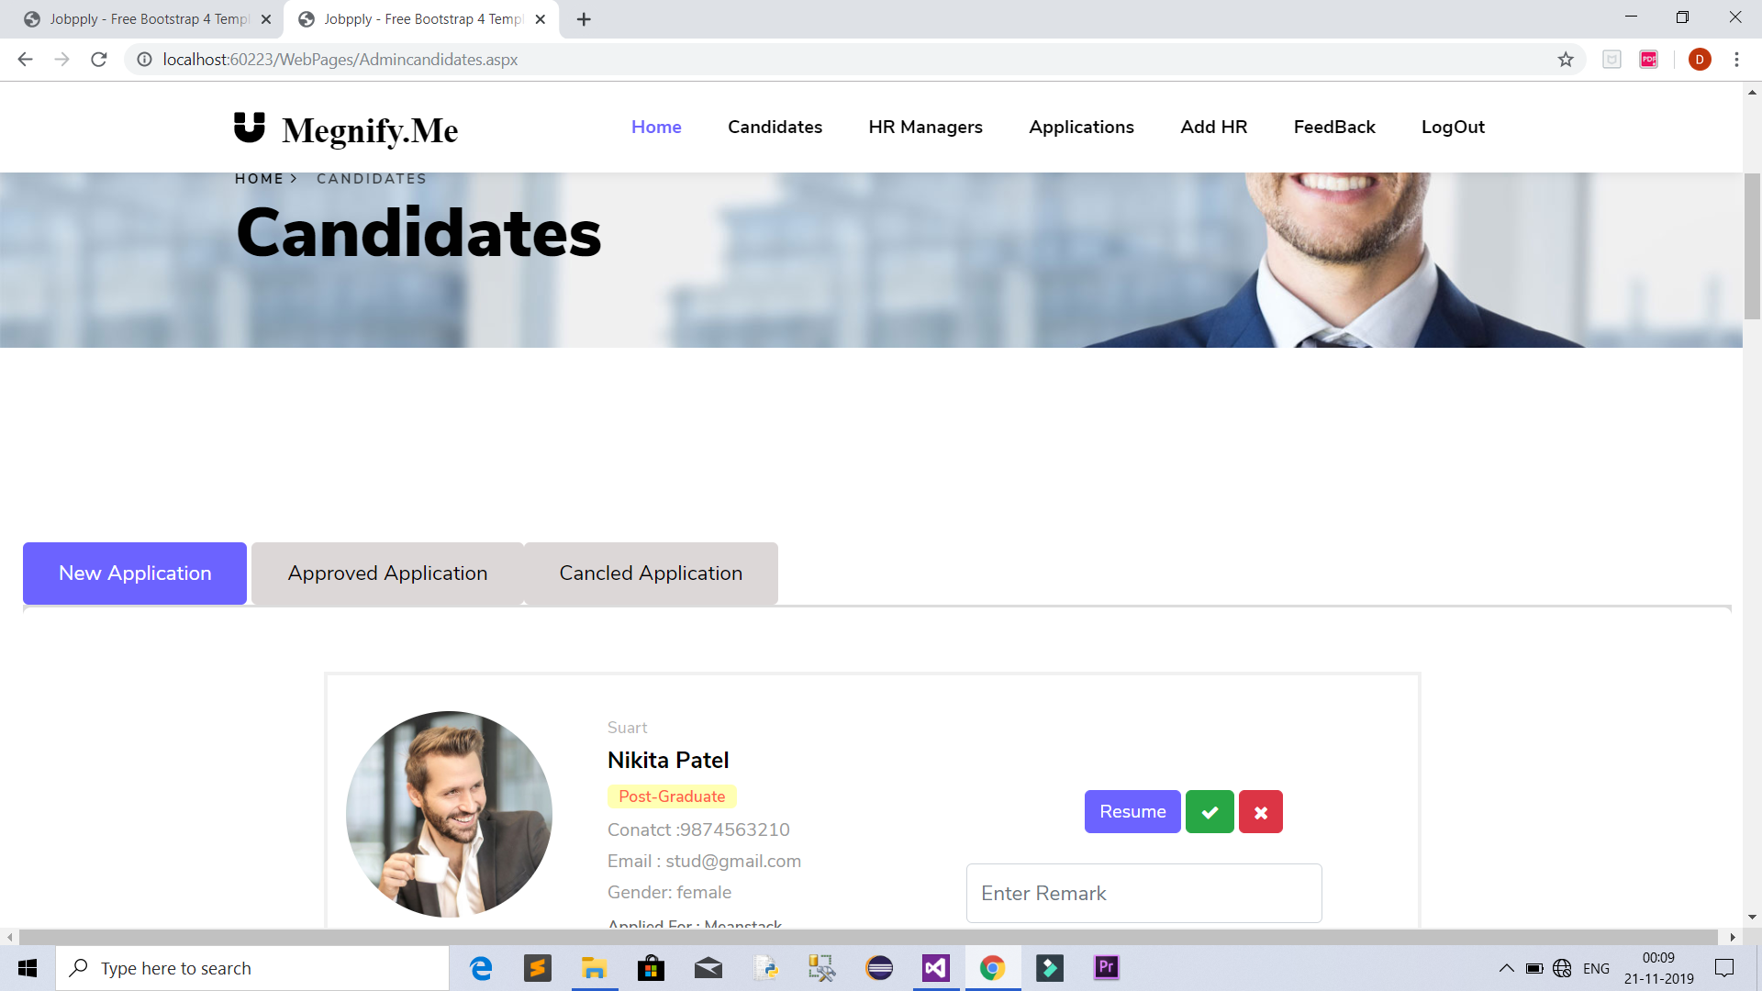

Slide 29
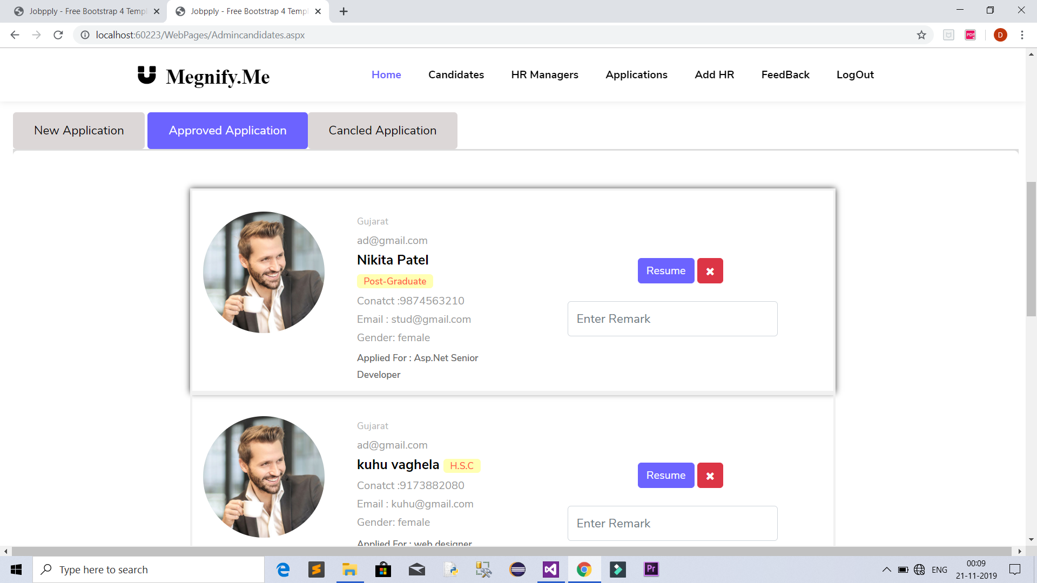

Slide 30
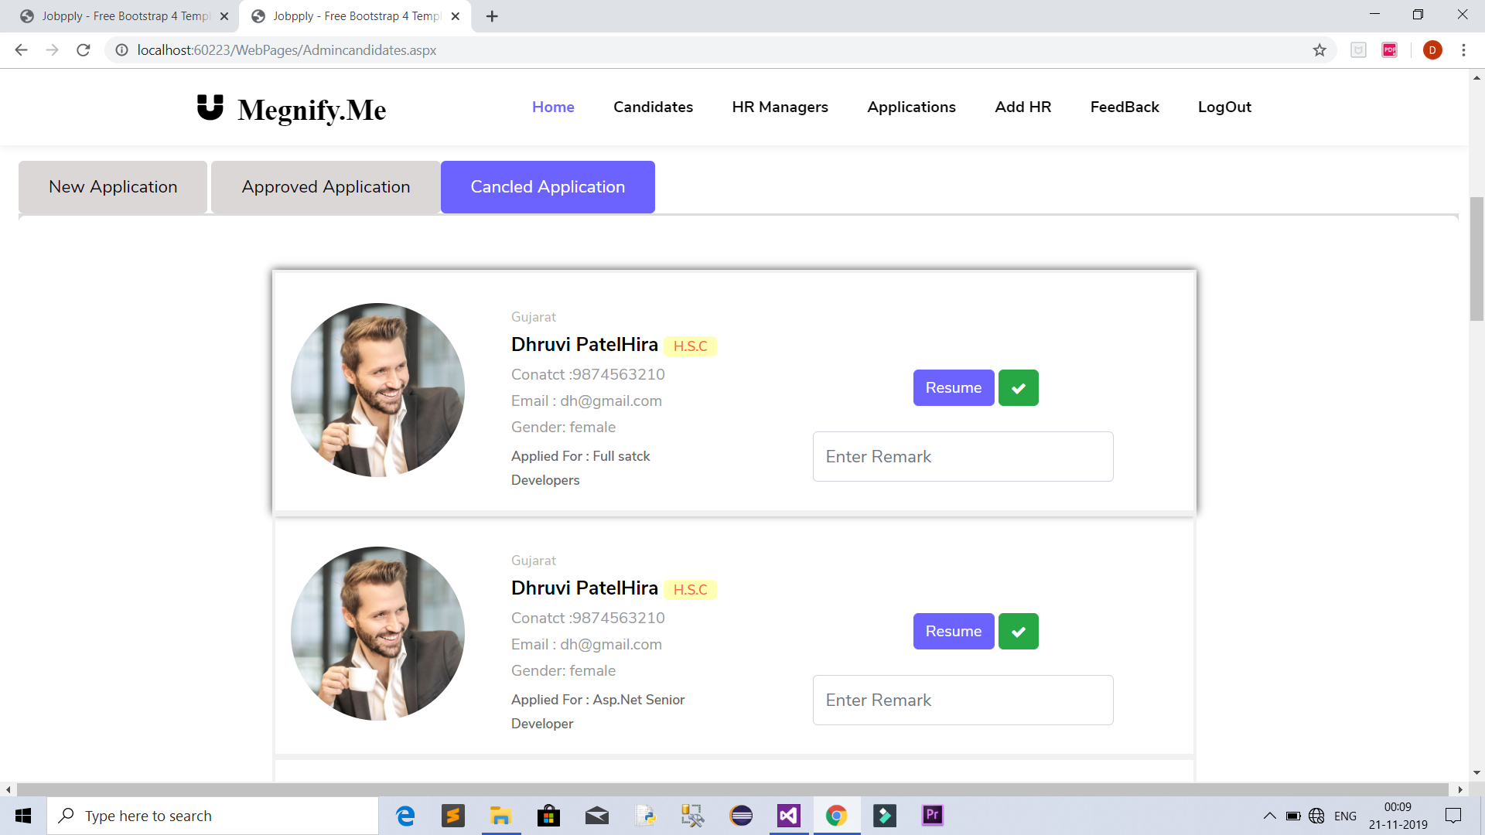

Slide 31
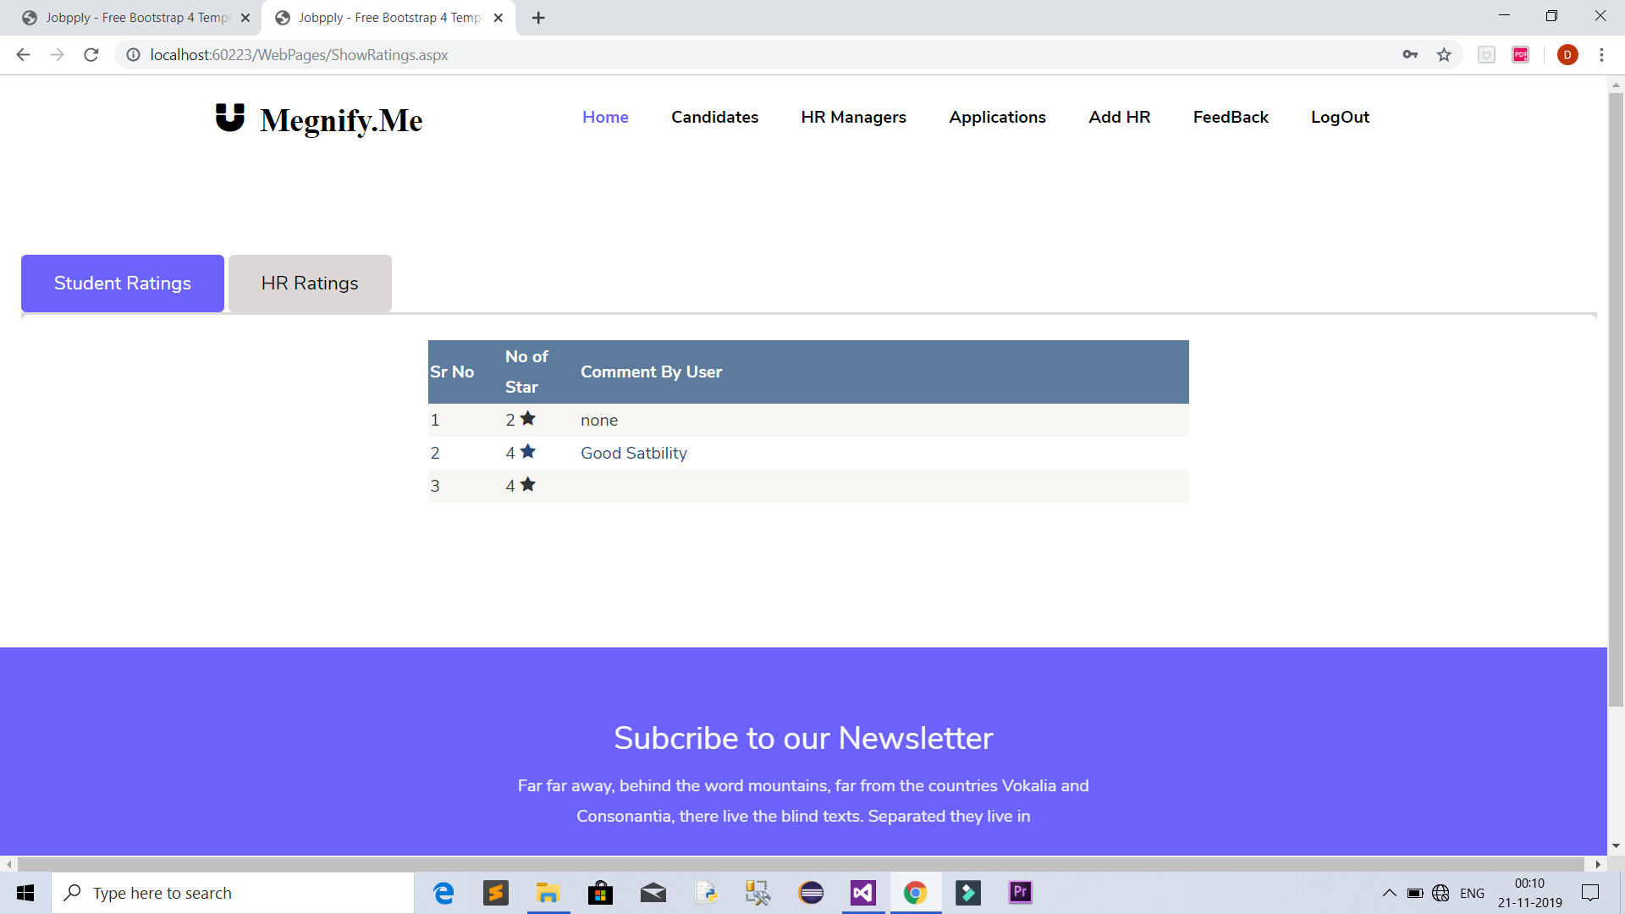

Slide 32
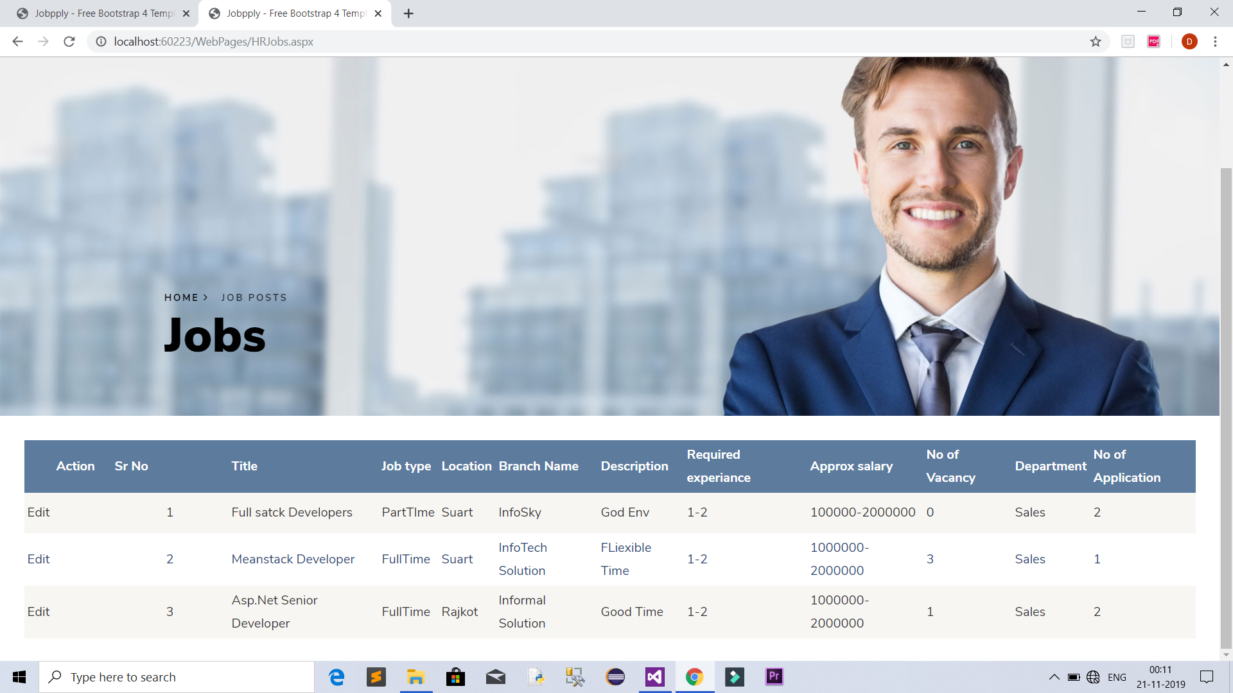

Slide 33
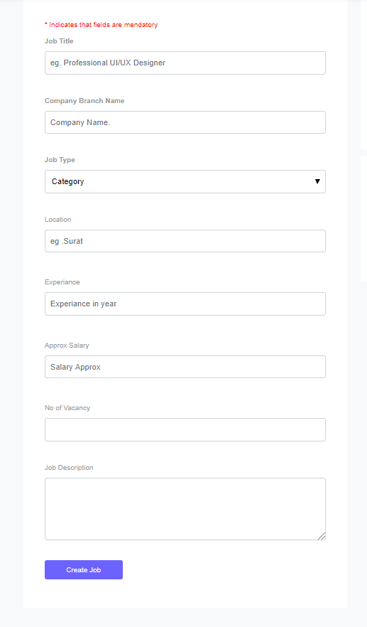

Slide 34
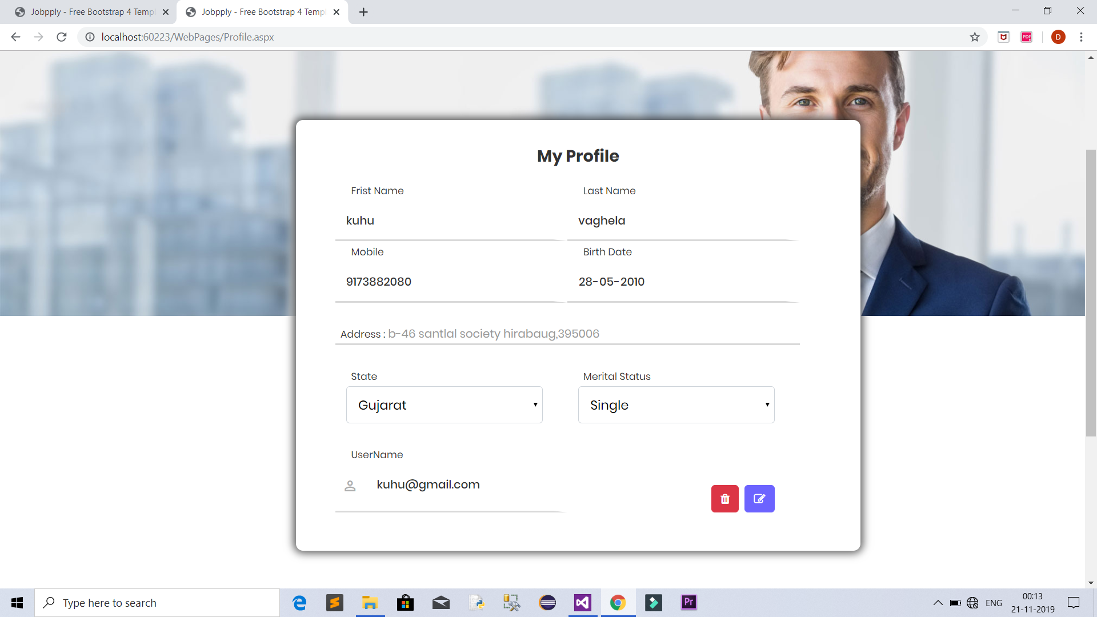

Slide 35
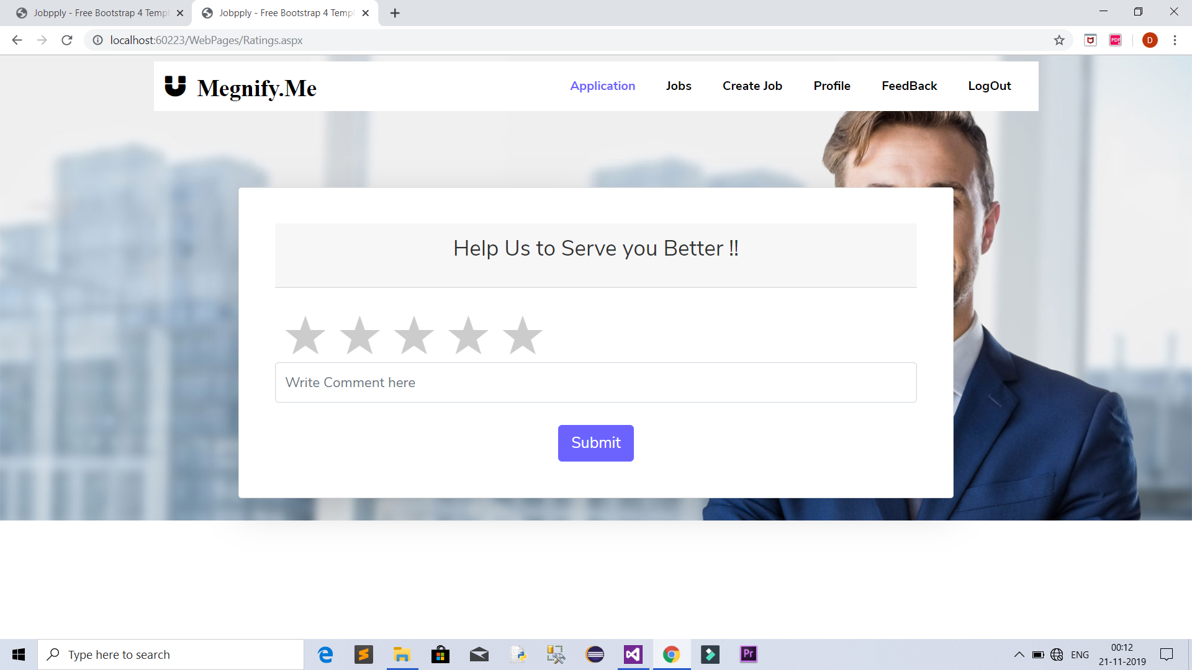

Slide 36
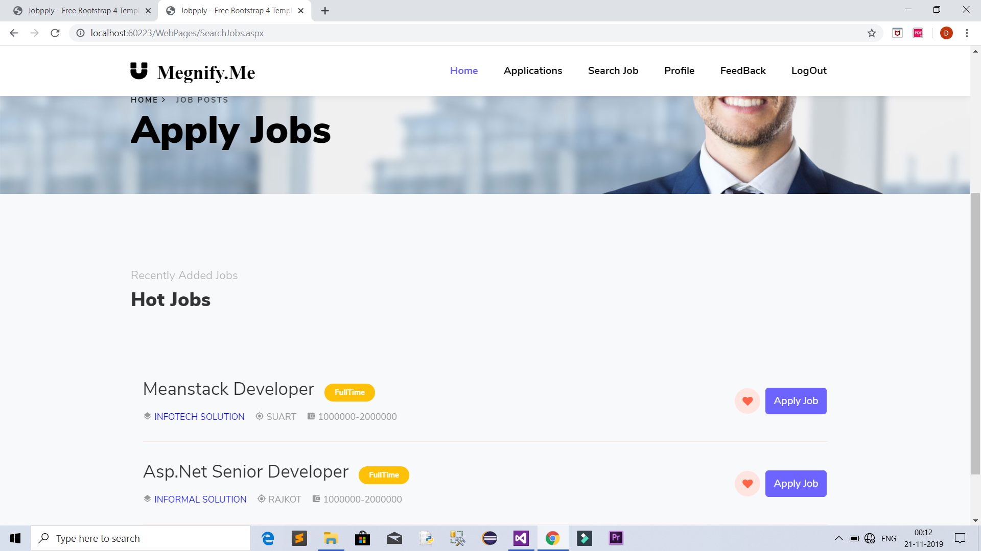

Slide 37
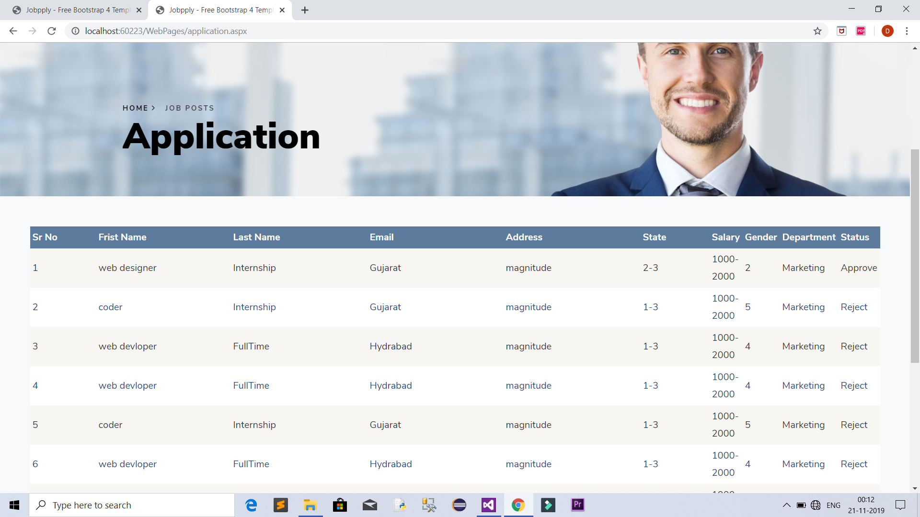

Slide 38
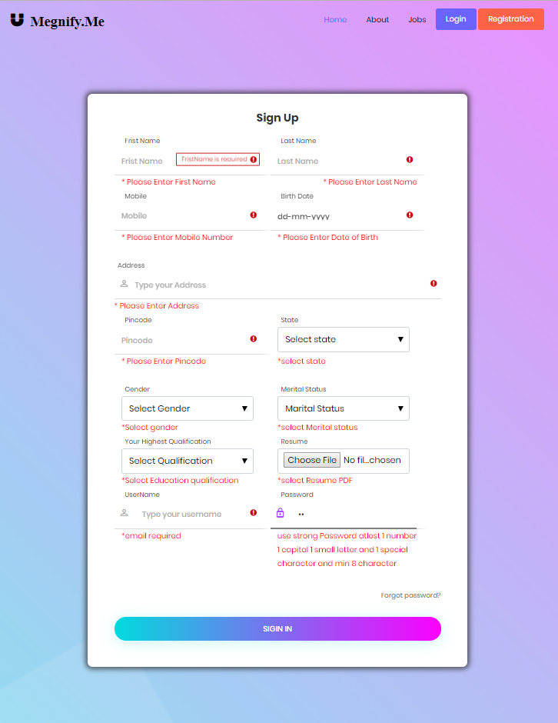
Test Cases Registration:

Slide 39
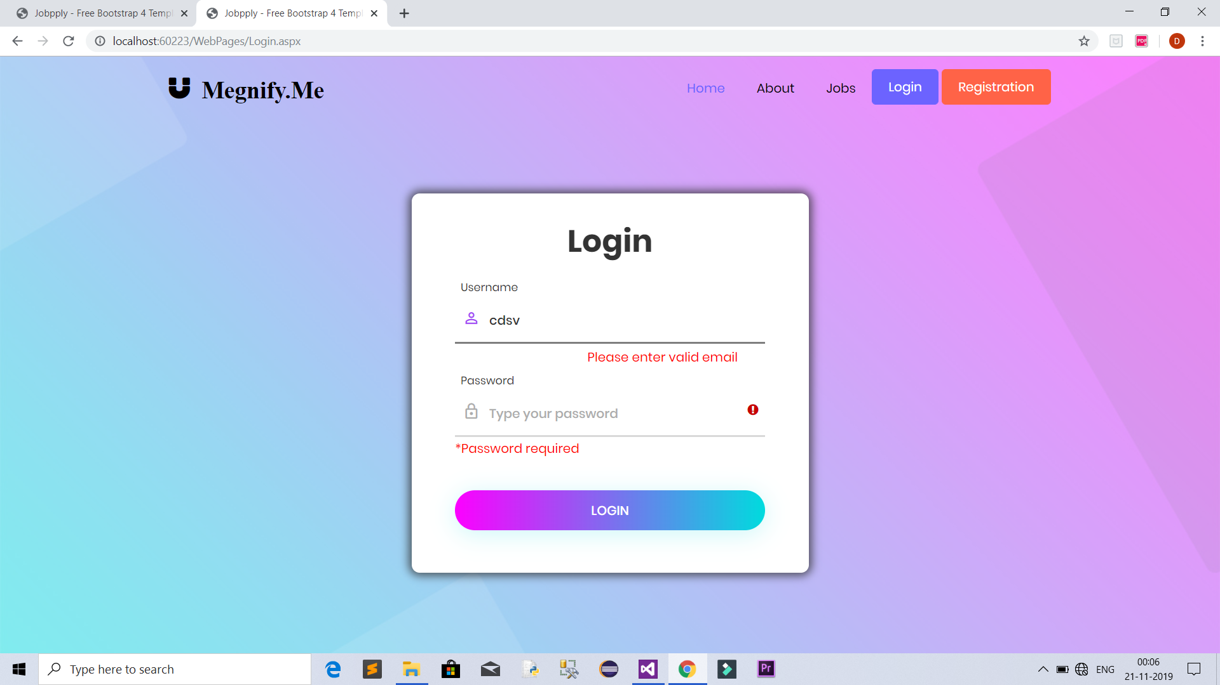
Login:

Slide 40
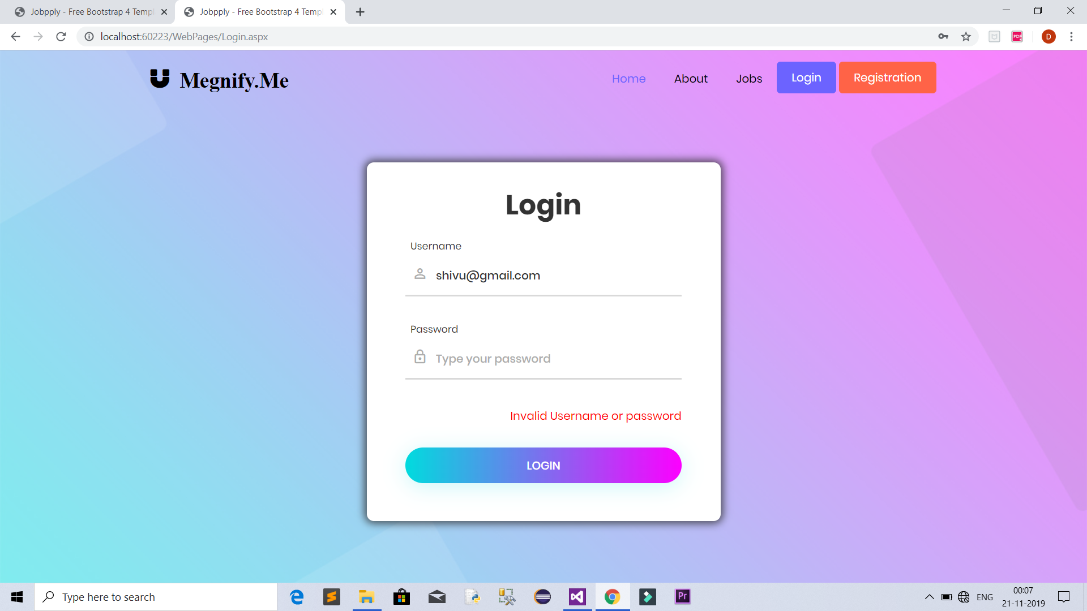

Slide 41
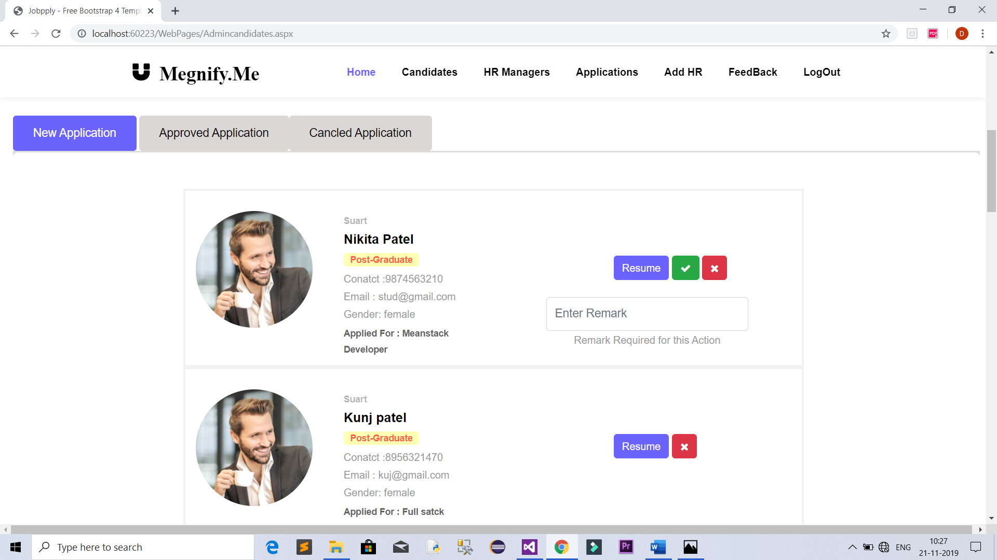
Approve or Reject page:

Slide 42
Future Enhancement of The Project and Conclusion
FutureEnhancement:
• More efficient and easy to use.
• Less redundancy.
• Interviewing will be done after approval of application.
Conclusion:
• This system of an online job portal system where job seeker can apply for job from anywhere over the internet.

Slide 43
Learning during the project work :
Pressure and confidence.
Self learning attitude.
Team work.
How to manage time.

